Slide 1
An Electric Craving
UCSD Data Science and Programming Bootcamp
Project One
Jacob Zacarias
Sanabu Washizuka
Tanlin Hung
Walaa Alani

Slide 2
Introduction
"Todd"
Lives in San Diego, CA
Enjoys rock climbing
A foodie
Looking to buy a new car
(FIND CLIPART/DRAWING/PHOTO OF RANDOM GUY AND INSERT HERE. ENSURE THE ART IS FREE USE.)

Slide 3
Theme of the Study
Should I get an electric vehicle over a gas-powered car?

Slide 4
EV or Gas Car?
Q1. Will I be able to find charging stations wherever I am?
Q2. Out of both categories (EVs and gas-powered cars) which make and model is the most cost-effective for their fuel?
Q3. Will EVs really pay themselves off?
Q4. What factors might hint that a city has a lot of charging stations?
Q5. How much will I save on a trip?

Slide 5
Brief Summary of findings
Q1. Will I be able to find charging stations wherever I am?
(summary here?)
Q2. Out of both categories (EVs and gas-powered cars) which make and model is the most cost-effective for their fuel?
(summary here?)
Q3. Will EVs really pay themselves off?
(summary here?)

Slide 6
Brief Summary of findings
Q4. What factors might hint that a city has a lot of charging stations?
Most all of the observed factors, including population density and gas prices, did not show a significant correlation between those factors and the number of charging stations available in the city. (except for maybe one of these factors…)
Q5. How much will I save on a trip?
(summary here?)

Slide 7
Q.4 What factors might hint that a city has plentiful charging stations?
"If I were to move or travel elsewhere, what other factors could I look at to see how reliably I can find a charge station?“
In other words, what properties of a city correlates with how many charge stations are available there?

Slide 8
Q.4 Correlational Study
Correlational Study of the "No. of Charge Stations" against other factors within a city
Review "No. of Charge Stations" against :
City Population Density (metropolitan areas = more charge stations?)
Gas Prices (CA only study) (cheaper gas = more charge stations?)
Institution type 1 (to be named later) (more “institution type 1” = more charge stations?)
Institution type 2 (to be named later) (more “institution type 2” = more charge stations?)

Slide 9
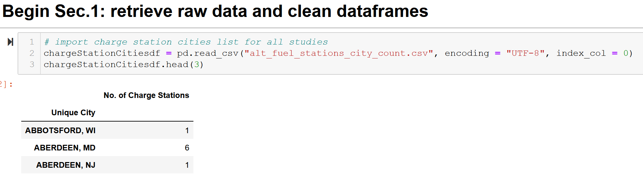
Q.4.1 – Charging Station List

Slide 10
Q.4.1 - City List and City Population Density (cleaning)
Source:
https://simplemaps.com/data/us-cities
General Info:
Information on cities in the U.S.
Updated as of November 18, 2020
Over 108,000 cities and towns from all 50 states
Used to retrieve current data on population density per city

Slide 11
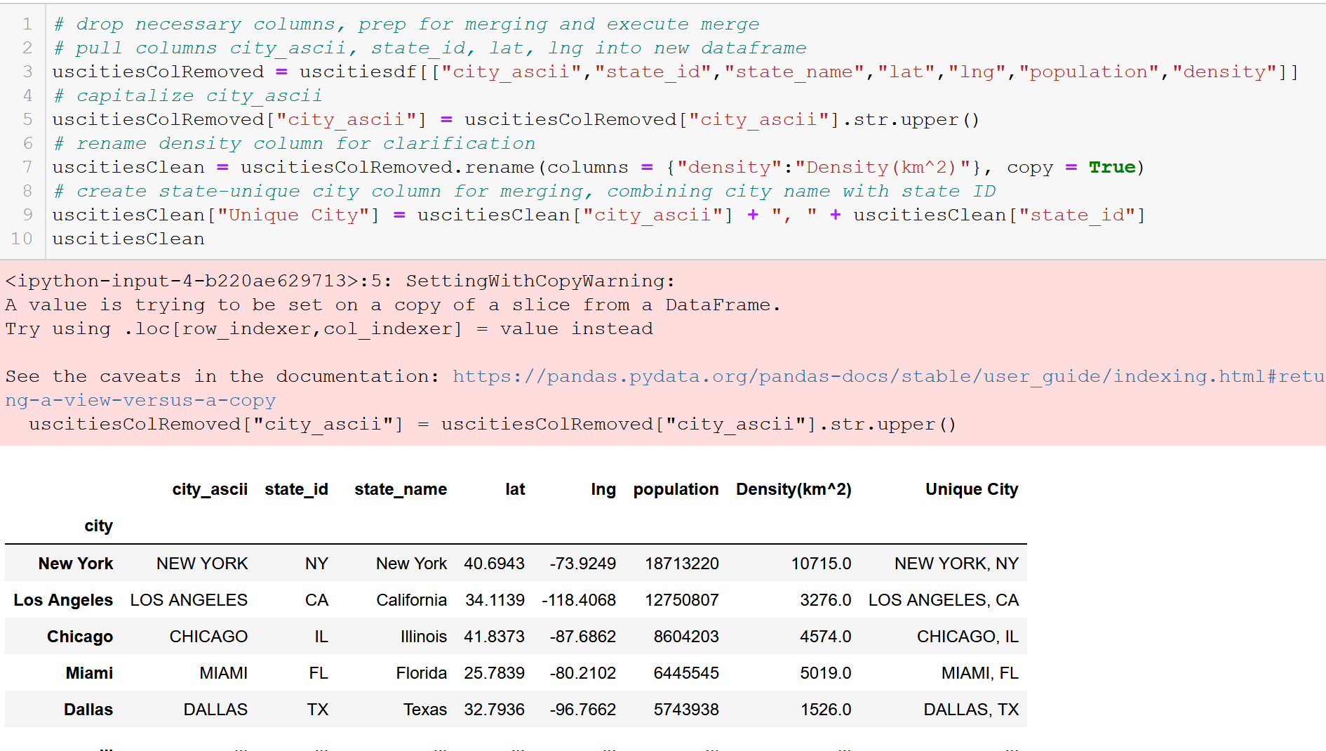
Q.4.1 - City List and City Population Density (cleaning)
*Note line 9

Slide 12
Q.4.1 – Urbanized Areas (cleaning)
Source:
https://en.wikipedia.org/wiki/List_of_United_States_urban_areas
General Info:
A list of urban areas in the United States as defined by the United States Census Bureau
An urbanized area (UA) is an urban area with population over 50,000
Used to limit cities to observe for API call

Slide 13
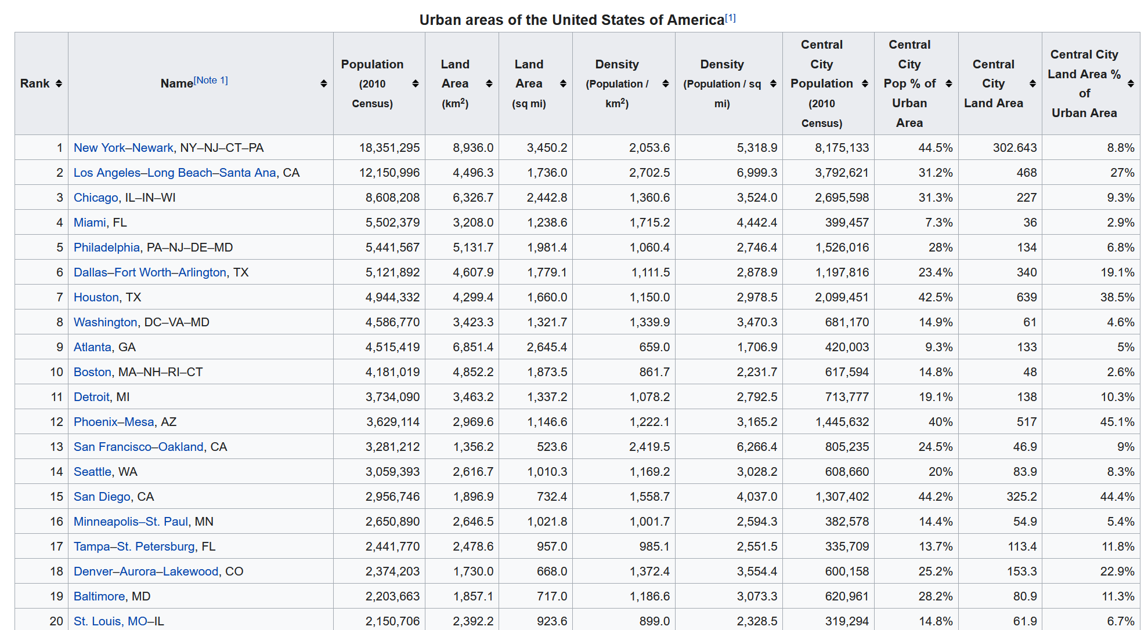
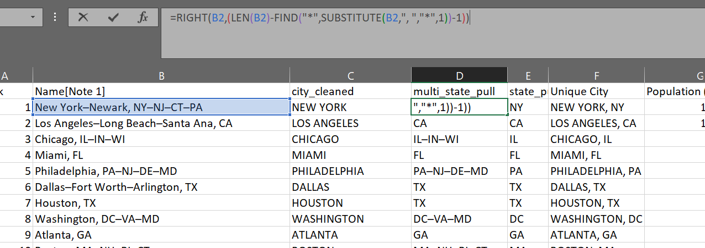
Q.4.1 – Urbanized Areas (cleaning)
Creating state-unique city names within Excel for merging

Slide 14
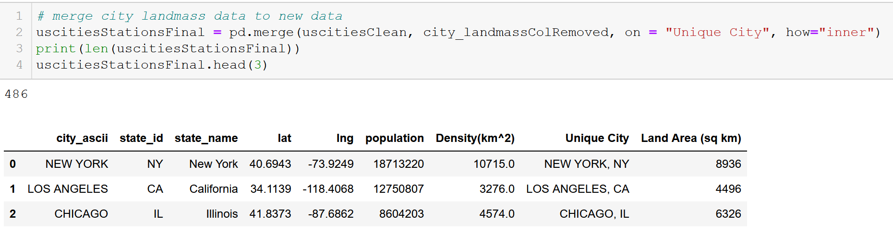
Q.4.1 – Merge urban areas list to city data frame to limit city count
Limiting cities to “Urbanized Areas” (population > 50,000)
Merging cities dataframe with “city_landmass” dataframe

Slide 15
Q.4.2 – CA Gas Prices (cleaning)
Source:
https://gasprices.aaa.com/state-gas-price-averages/
General Info:
A list of gas prices within California per city

Slide 16
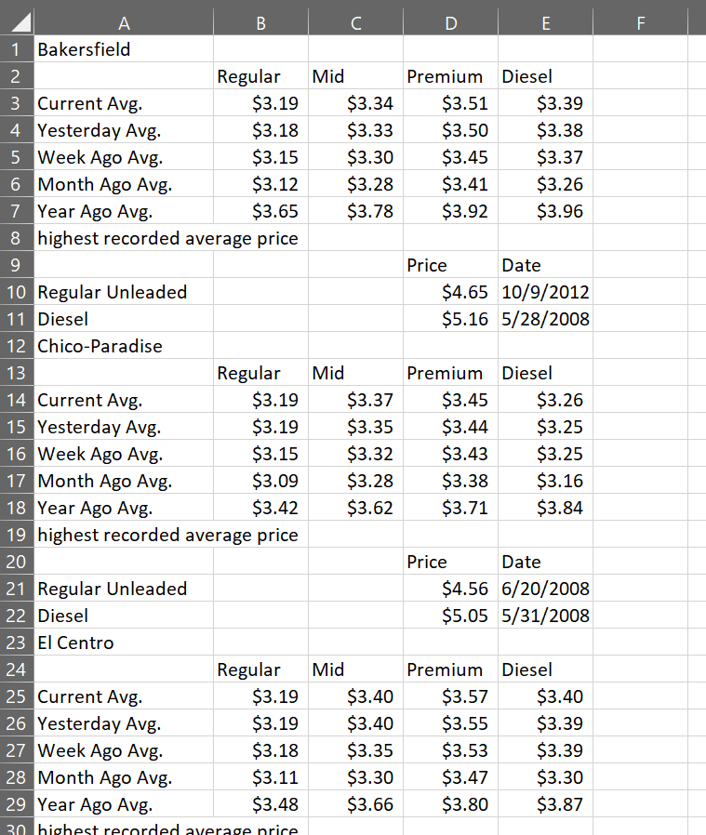
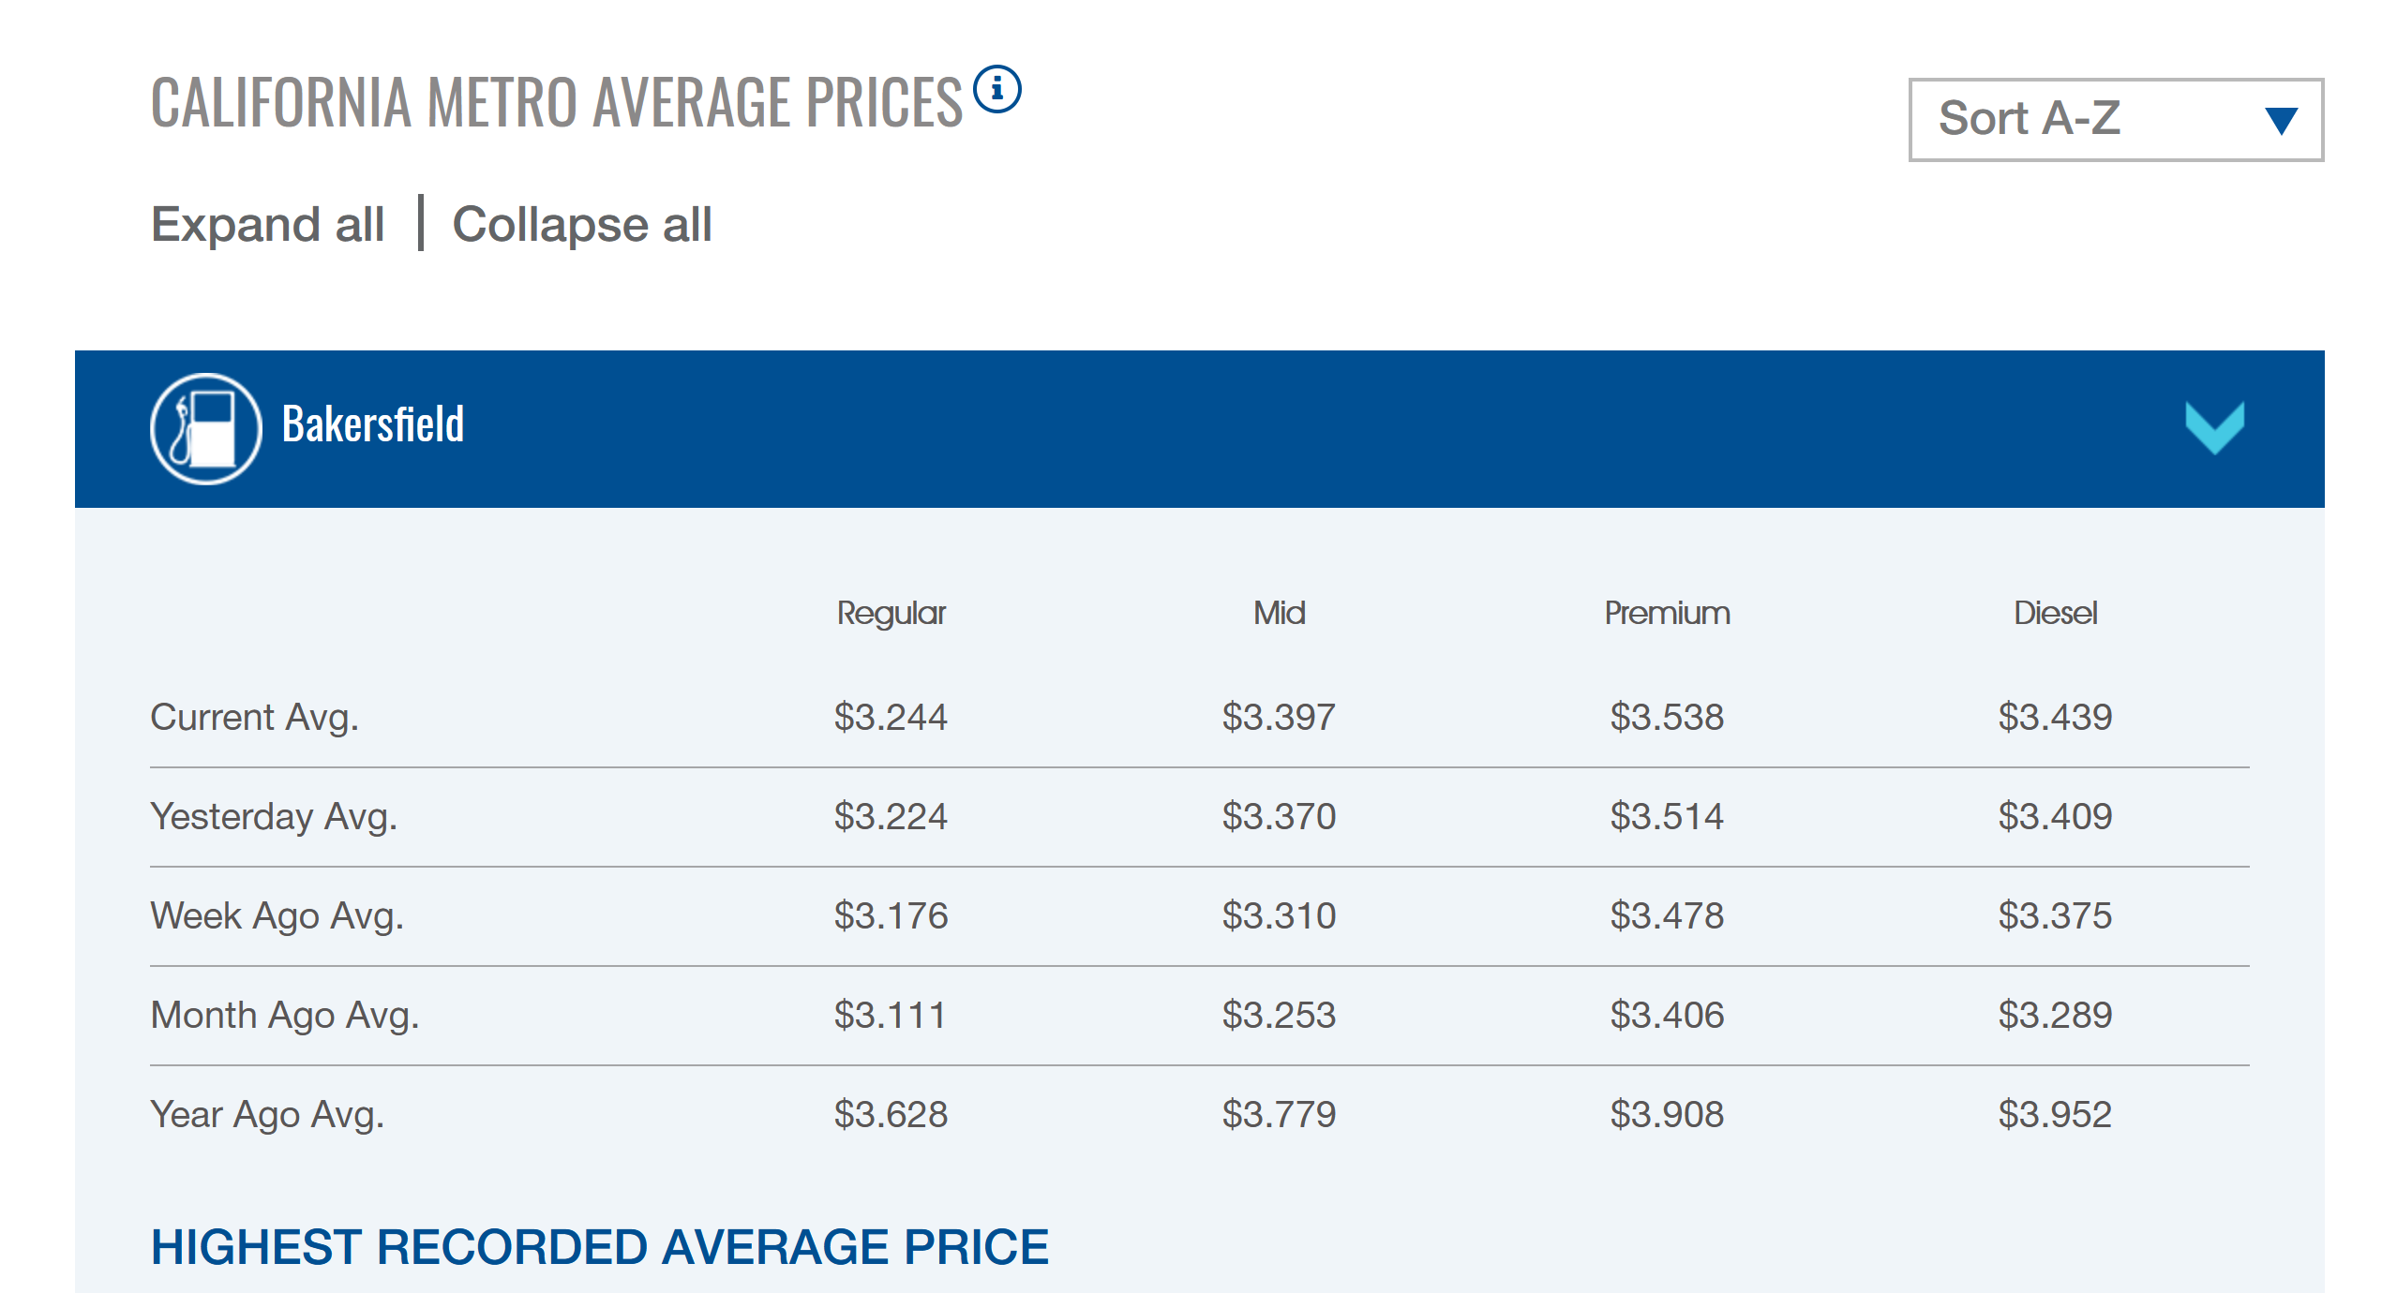
Q.4.2 – CA Gas Prices (cleaning)
Copy/pasted data directly off website onto Excel spreadsheet

Slide 17
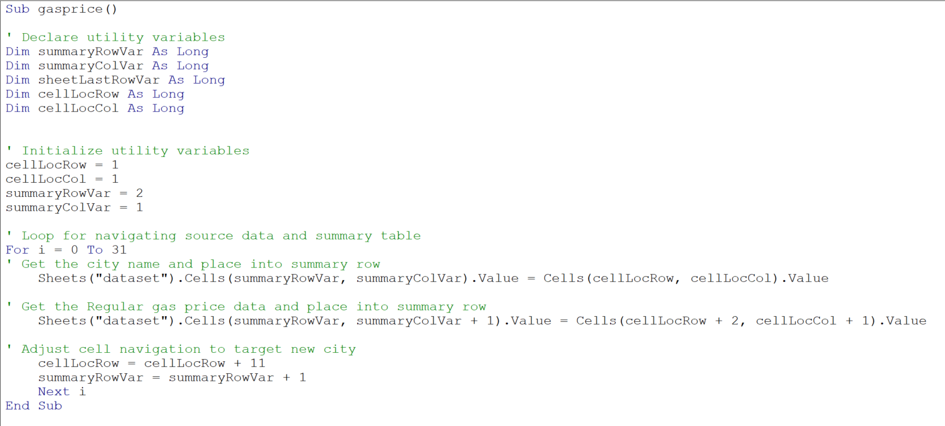
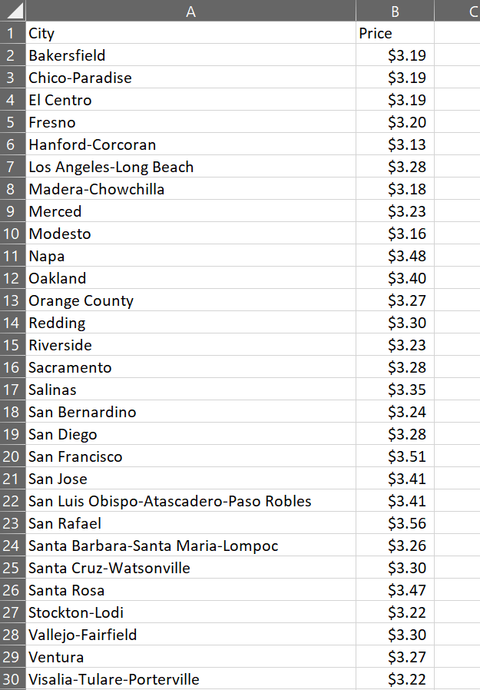
Q.4.2 – CA Gas Prices (cleaning)
Created crawler to pick out necessary data and create a summary table

Slide 18
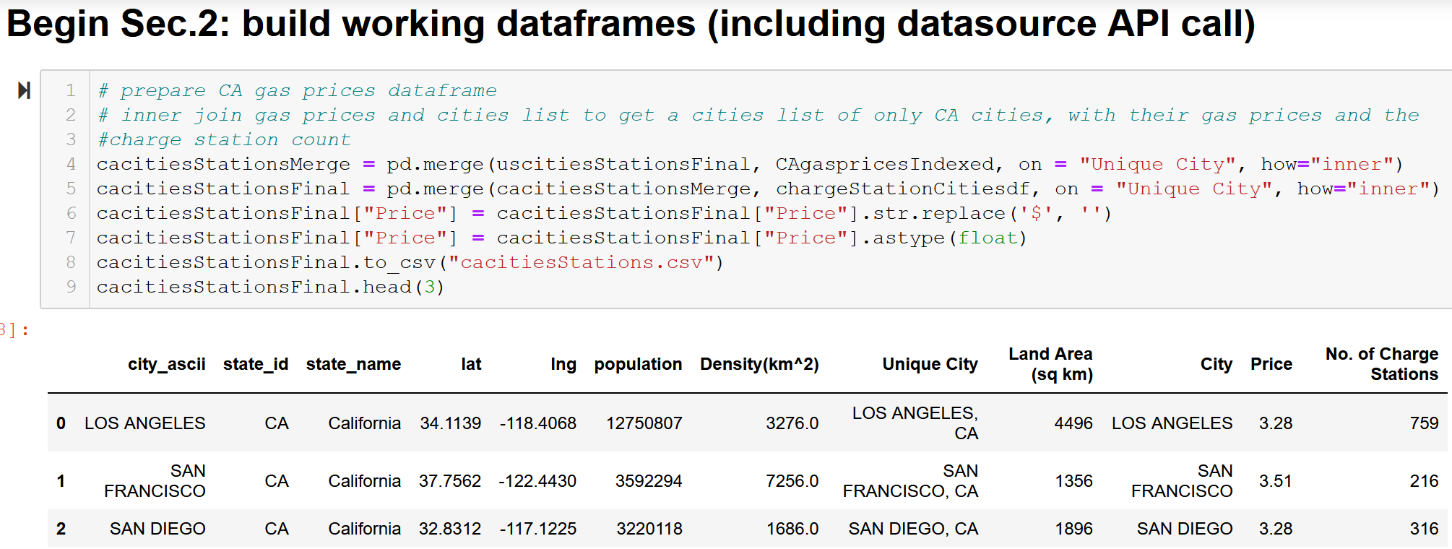
Q.4.2 – Cities data for Gas Prices (merging)
Creating CA-only list of cities and average gas prices (Regular octane gasoline) with number of EV charge stations for each city
Capitalize city name and add state abbreviation, and inner join on the unique cities

Slide 19
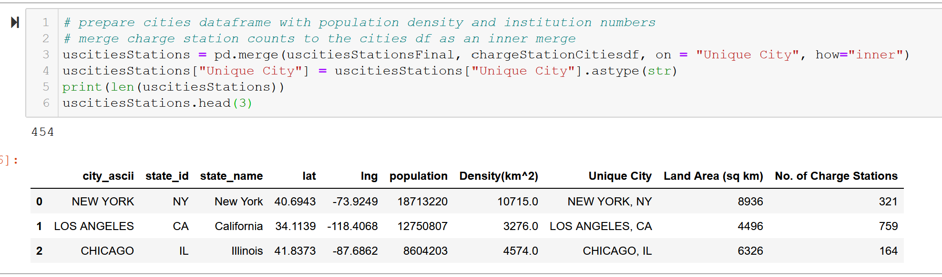
Q.4.1 – Cities Data for Population and “institutions” Studies
Inner join on state-unique cities
Change Price measures to floats

Slide 20
Q.4.3/4
Data cleaning/merging is finished for the first two studies
But what happened to the other two studies on the “institutions”???
(We’ll get back to these)

Slide 21
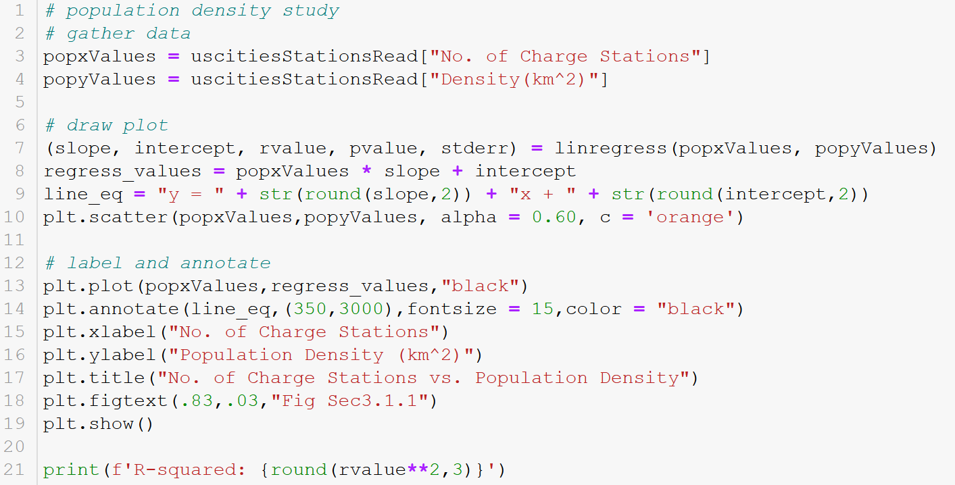
Q.4.1 – Creating scatterplot with R^2

Slide 22
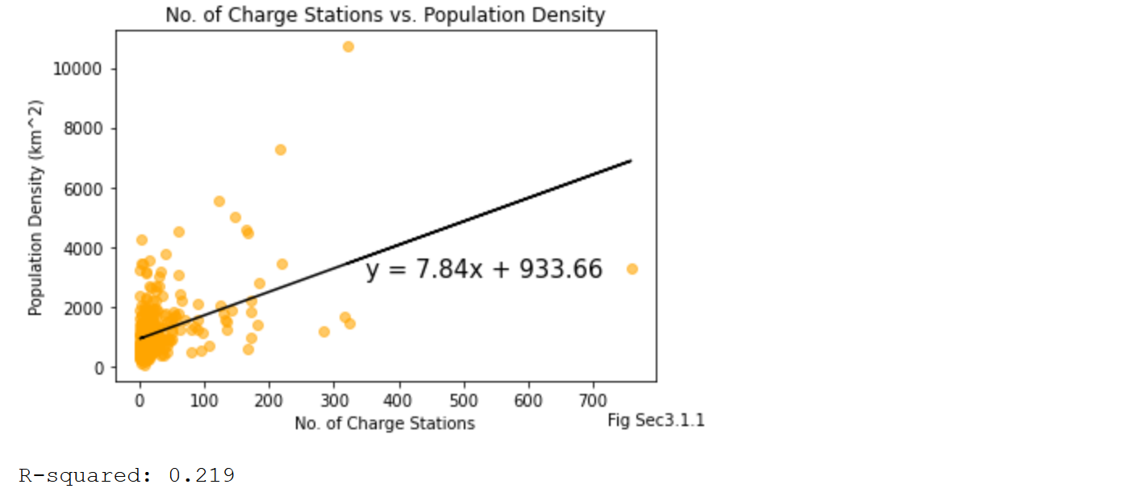
Q.4.1 – Scatterplot for Q.1

Slide 23
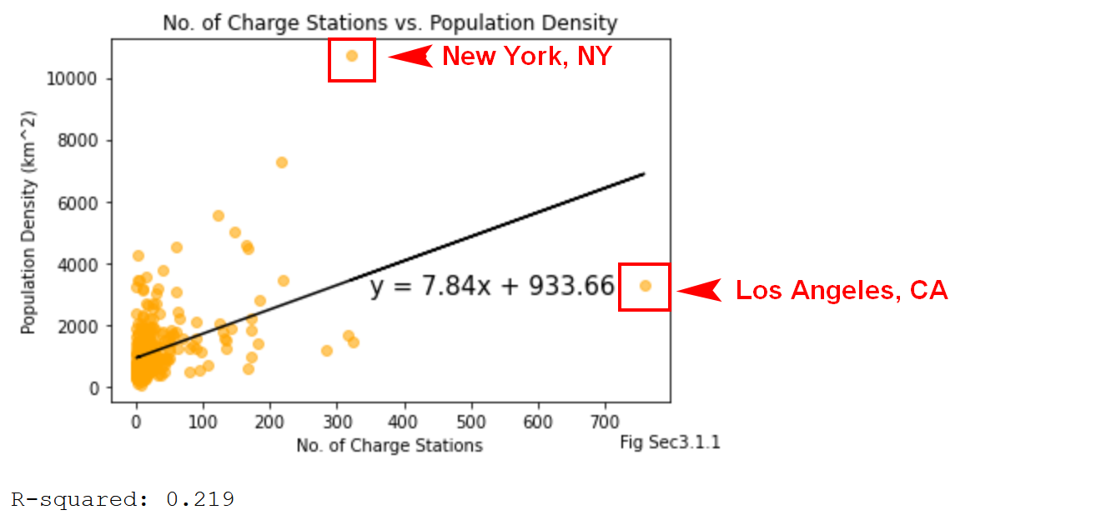
Q.4.1 – CA Cities data for population and “institutions” studies
Weak R-squared – likely no correlation between no. of charge stations and population density

Slide 24
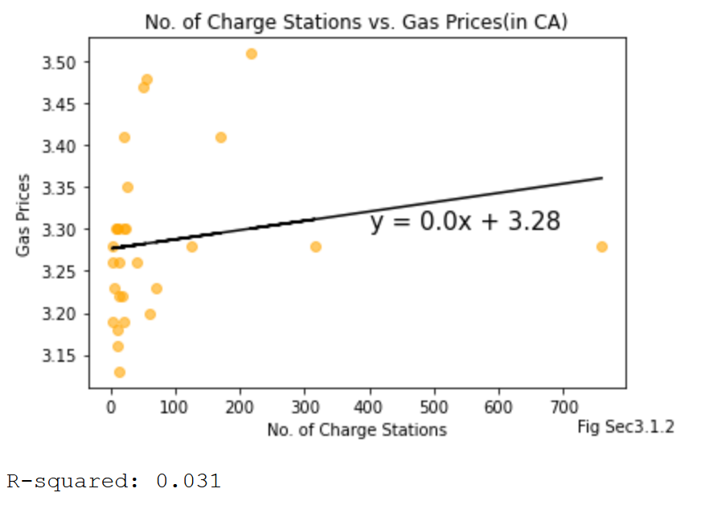
Q.4.1 – CA Cities data for population and “institutions” studies
Weak R-squared – likely no correlation between no. of charge stations and gas station prices
Higher R-squared than population density

Slide 25
Q.4.3/4 What else is there?
Cities with a “techie” vibe
Representative of trendy, forward-thinking demographics

Slide 26
Q.4.3/4 What else is there?
SB LOGO

Slide 27
Q.4.3/4 – Yelp API
Use Yelp API to search for number of Starbucks in each city
Loop through cities data frame and make calls to the API for each city
Read through the responses from one page to the next until the first response that isn’t the search term is found

Slide 28
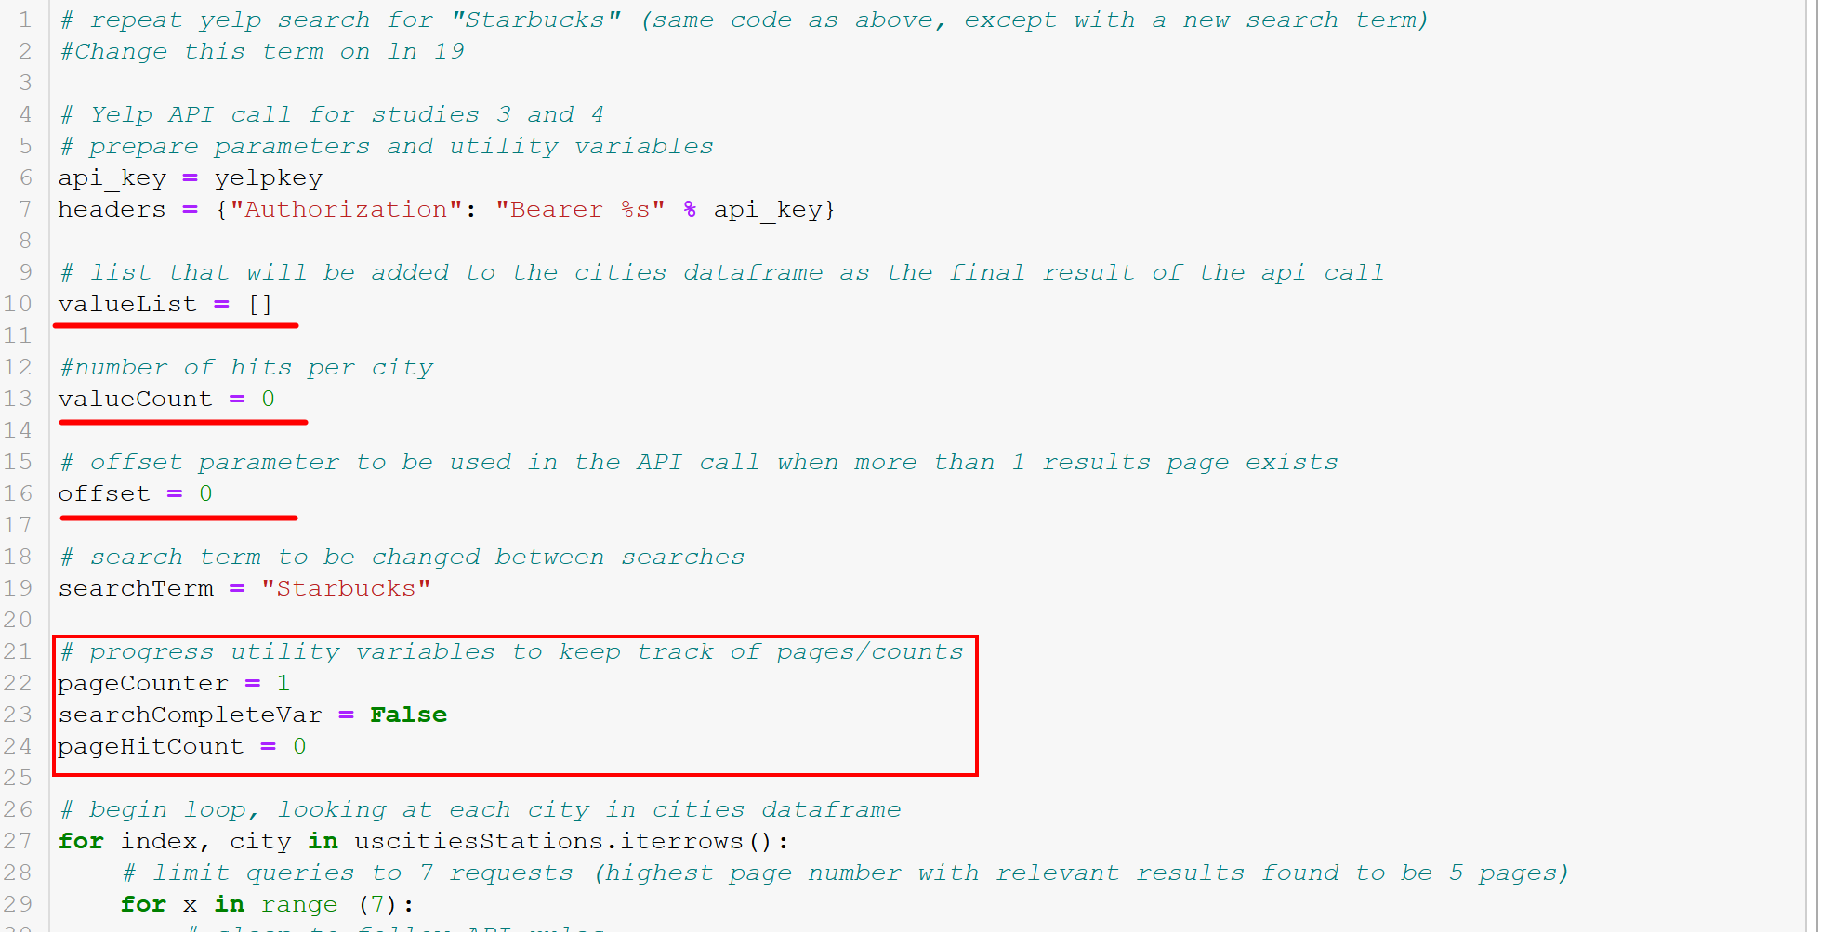
Q.4.3/4 – Yelp API

Slide 29
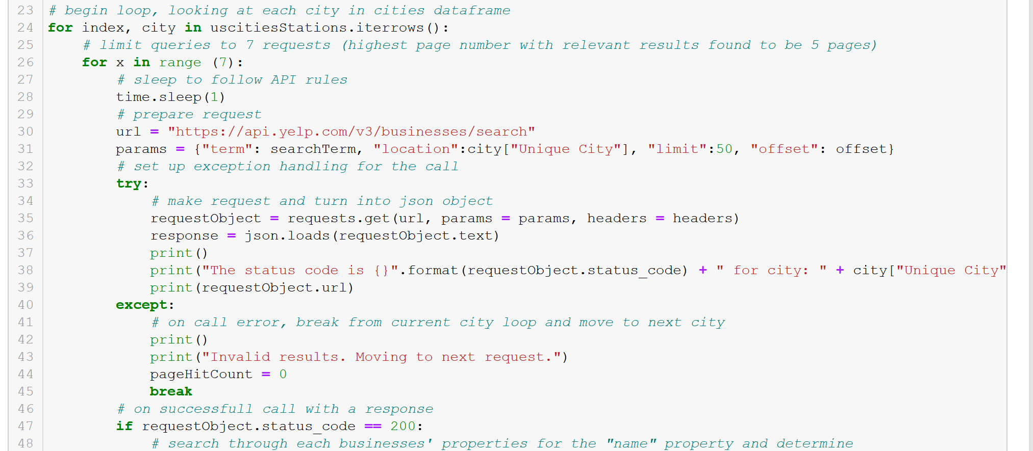
Q.4.3/4 – Yelp API

Slide 30
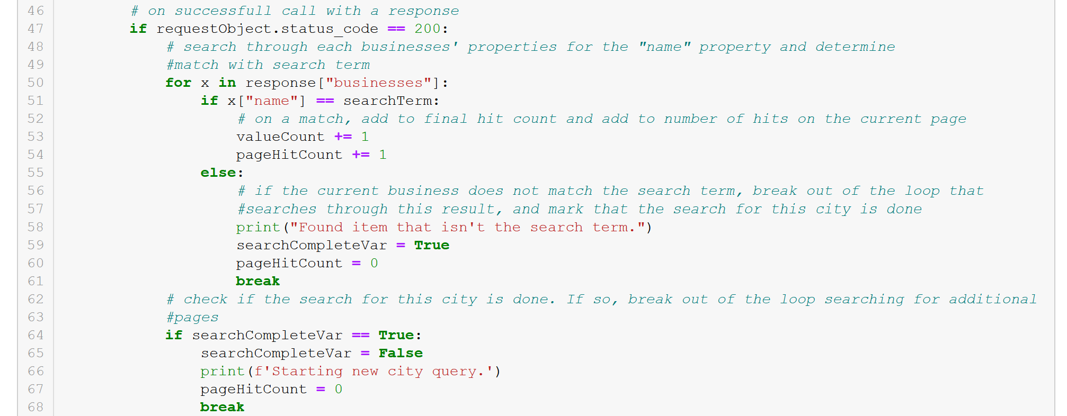
Q.4.3/4 – Yelp API

Slide 31
The “Electric” Craving
“IS HUNGRY”
(FIND CLIPART/DRAWING/PHOTO OF RANDOM GUY AND INSERT HERE. ENSURE THE ART IS FREE USE.)

Slide 32
The “Electric” Craving
FINDS BOSTON RESTAURANT AND HAS TO GO THERE

Slide 33
The “Electric” Craving
IS CURRENTLY IN SD AT A BURITTO SHOP

Slide 34
The “Electric” Craving
QUESTION

Slide 35
The “Electric” Craving
GAS CAR

Slide 36
The “Electric” Craving
EV

Slide 37
The “Electric” Craving
RESULTS 1

Slide 38
The “Electric” Craving
RESULTS IN TERMS OF TRIPS

Slide 39
The “Electric” Craving
RESULTS IN TERMS OF NO. OF FOODS

Slide 40
Sources

Slide 41
An Electric Craving
UCSD Data Science and Programming Bootcamp
Project One
Jacob Zacarias
Sanabu Washizuka
Tanlin Hung
Walaa Alani

Slide 42
Topic Slide
CONTENT HERE

Slide 43
Subtitle
CONTENT HERE

